Slide 1
Processes – Threads and Scheduling
Module CSN08101
Systems and Services
School of Computing Napier University

Slide 2
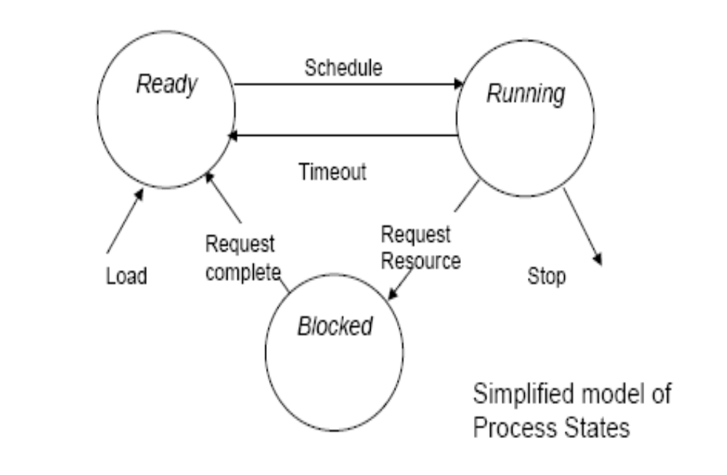
Processes and Process States - 1

Slide 3
Processes and Process States - 2
➘ The possible states of the process are:
➘ Ready-to-Run
➘ A process in this state is not actually running, but could be run if it were
assigned to the processor - i.e. if a processor were available.
➘ There could be several processes in this state at any time.
➘ Running
➘ The CPU registers hold values from this process and the current
instruction sequence comes from this process.
➘ There is only one process in this state in a single processor system.
➘ Blocked
➘ A process in this state could not run even if the processor were free.
➘ The process is usually waiting for some “slow” device to provide input
or accept output - e.g. a process that is waiting for a user to enter data
will be “blocked” until the user types in the data.
➘ There could be several processes in this state at any time.

Slide 4
The Process Descriptor -1
➘ The “process status areas” shown in the memory map of a process image
is sometimes called the “process descriptor” .
➘ It may exist as part of the process, as shown in these slides.
➘ In this case the descriptors (status areas) of the current processes are
“chained” together to form a list of processes.
➘ The scheduler uses this list to decide which process to run next
➘ Alternatively it may exist as a table of entries held within the operating
system.
➘ In this case the descriptor (table entry) for each process contains pointers
to the other parts of the process.
➘ Each descriptor therefore describes one process and is a record of the
process.
➘ When a process is created, its status area is linked to the chain, or a
table entry is created (depending on the approach taken).
➘ When the process terminates the entry is removed from the chain or
the table

Slide 5
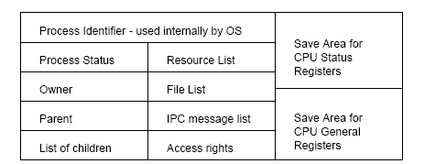
The Process Descriptor -2
➘ The table entry below shows the contents of a typical process descriptor as it
might appear in the process status area.
➘ In a table form, this would also include pointers to the other parts of the
process in memory
➘ For example, the “process status” would show “running”, “ready” or “blocked”.

Slide 6
The Process Descriptor - 3
➘ This table, or chain, is “visible” to most OS processes, e.g:
➘ If a file is opened, its identifier is added to the File List
➘ before opening the file the OS will check the process’s access rights
➘ The scheduler uses this table to decide which process to run next,
➘ Messages from other processes can be placed in the IPC (inter-process
communication) List
➘ As only one process is running at any time this is how processes
communicate with each other.
➘ The size of the table,or length of the chain, is preset to the maximum
number of processes that can be accommodated.
➘ The actual number of processes may be smaller because of resource
constraints.
➘ As processes are closed down , the entries are re-used for new
processes.
➘ A special purpose OS may have a fixed set of processes - e.g. an
industrial controller

Slide 7
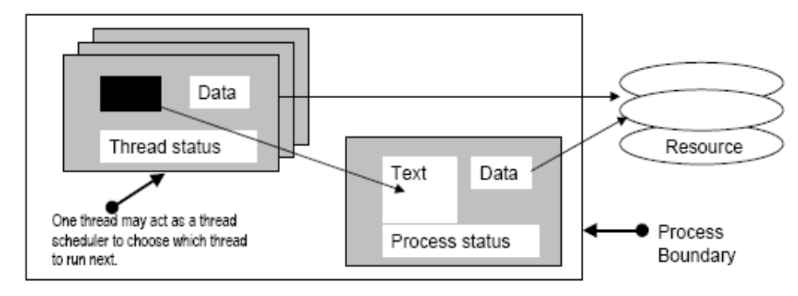
Threads
➘ A “process” has a defined memory space accessible only to that process.
➘ Switching the CPU from one process to another takes a relatively long
time.
➘ First copy contents of all CPU registers to the save area, choose the
next process,
then load the CPU registers with the values from the save area of
that process.
➘ An alternative approach is to use “threads” or “threaded processes:

Slide 8
Threads -2
➘ The process is divided into several mini-processes or “threads”
➘ Each thread:
➘ contains a stack, some status information and some OS table details.
➘ can share the Text, data and resources of the main process.
➘ The main scheduler selects the process as before.
➘ Within that process a “thread scheduler” allocates the available
timeslice between the threads.
➘ Switching between threads involves only saving thread status
because the same process is still “running”.
➘ If none of the threads can make progress (or the main scheduler
interrupts) the process will stop being the running process.
➘ For example, Netscape or Internet Explorer can load several parts of a
page “simultaneously” (- Look at the BBC News website)
➘ One issue is whether the “thread scheduler” should be part of the kernel
(ideal) or part of the process (often as an extra thread).

Slide 9
The Low-level Scheduler - 1
➘ This is a process which is invoked when a “new” process is to be
allocated to the processor.
➘ This is usually when the running process blocks or terminates, but it may be
after a sequence of tasks (batch systems).
➘ The choice of process is made using a scheduling algorithm.
➘ Several algorithms are available: each selects a process from those in the
“ready-to-run” queue and makes it into the “running” process.
➘ FCFS - (first come first served).
➘ SJF - (shortest job first) - based on an estimate of how long the process is
likely to run before it terminates, or before the next blocking event.
➘ Round Robin - each process is allowed to run for a maximum timeslice (the
quantum) then put back into the ready-to-run queue.
➘ It may block or terminate before the end of the timeslice.
➘ Priority - some property of each process is used to define its importance - the
most “important” process is run next.

Slide 10
The Low-level Scheduler - 2
➘ Definitions:
➘ “turnaround time” is the time from first entry to the ready-to-run queue
until termination.
➘ “waiting time” is the time spent in queues (blocked or ready-to-run).
➘ “CPU-burst” as any period when a process is the running process.
➘ Each algorithm has different characteristics of turnaround time and
waiting time, for a given set of CPU-bursts.
➘ A major problem is that pattern of CPU-bursts is indeterminate.
➘ The algorithm that is best for one task mix may be less optimal for
another.
➘ FCFS - Simple. Used for batch systems. Short tasks can be delayed by
long tasks.
➘ SJF - Favours short tasks, giving better average turnaround and waiting
times.
➘ RR - Gives best response times for interactive tasks (implies short CPU -
bursts and longer periods blocked, waiting for I/O).

Slide 11
Scheduling algorithms
➘ The performance of a system as perceived by the user depends on many
factors, (including user expectations).
➘ Two common measures are:
➘ Mean turnaround time:
➘ average time in the system.
➘ Mean waiting time:
➘ average time spent ready-to-run or blocked.
➘ Consider a system with 3 processes in the “ready-to-run” state:
➘ The scheduler is about to select one to become the “running” process;
each process is expected to use different amounts of CPU time:
Process A - will require 6 units.
Process B - will require 4 units.
Process C - will require 2 units.
➘ The following slides show the behaviour of the system with different
algorithms (sometimes called scheduling policies).

Slide 12
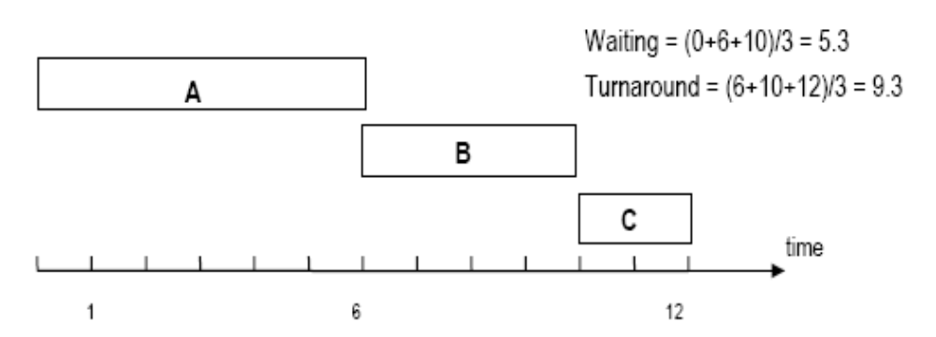
FCFS - First Come First Served
➘ The processes are placed in the ready-to-run queue in the order of
arrival:
➘ The first process becomes the running process (say, A then B then
C).
➘ There is no priority:
➘ short or important processes may have to wait for long
unimportant processes to release the CPU.
➘ This policy is simple to implement.

Slide 13
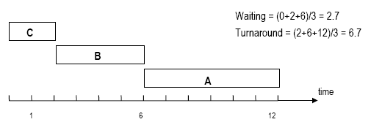
SJF - Shortest job first
➘ The processes are taken from the queue in the order of their estimated
CPU-burst time.
➘ The “shortest” process becomes the running process (in this case,
C then B then A).
➘ In effect, priority is given to “short” tasks.
➘ Estimates of CPU-burst time are difficult to make accurately.
➘ Results may not be as predictable in practice as in the theory.

Slide 14
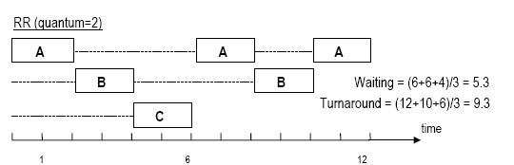
RR(q=n) - Round Robin (quantum=n)
➘ The processes are taken from the queue in some order (let’s assume FCFS).
➘ Note that the queue itself could be in another order - e.g. priority or
SJF).
➘ The process is allowed to run for a maximum time (e.g. the quantum
20mS)
➘ If the task does not finish in the quantum, it is returned to the
queue.
➘ Good for multi-user interactive systems.
➘ The length of quantum chosen affects performance.

Slide 15
Priority scheduling
➘ Some feature of the process is used to specify importance, or priority.
➘ SJF is a “priority” algorithm based on predicted CPU-burst.
➘ Other features could be resource demand, or simply a value assigned to
the process by the operating system.
➘ Priority can be related to the “user” who owns the process, to money
(pay more and get higher priority), or any value set by the system
manager.
➘ The scheduler selects the process with the highest priority from the ready-to-
run queue and makes it the running process.
➘ A process may be passed over many times (there may always be another
processes with a “higher” priority.
➘ Some algorithms raise the priority of a process every time it is passed
over - eventually it must become the highest priority process.
➘ This is called “ageing”.

Slide 16
Other scheduling issues
➘ Some systems have several queues of processes.
➘ Each queue may have its own algorithm.
➘ An “interactive”stream using RR with a priority queue.
➘ A “background” stream using an FCFS queue.
➘ There may be an algorithm to select between the queues.
➘ Run an interactive job if there are any, otherwise a background job.
➘ Real queues are dynamic - new processes enter the queue, processes
terminate unexpectedly, blocked processes rejoin.
➘ The queue may change radically between any two scheduling events
(i.e. any two runs of the scheduler).
➘ Pre-emptive scheduling means that a process might not be allowed to
continue to the end of its time-slice:
➘ The running process may be swapped-out prematurely (or pre-emptively)
by the scheduler to allow the system to deal with some other process.

